Slide 1
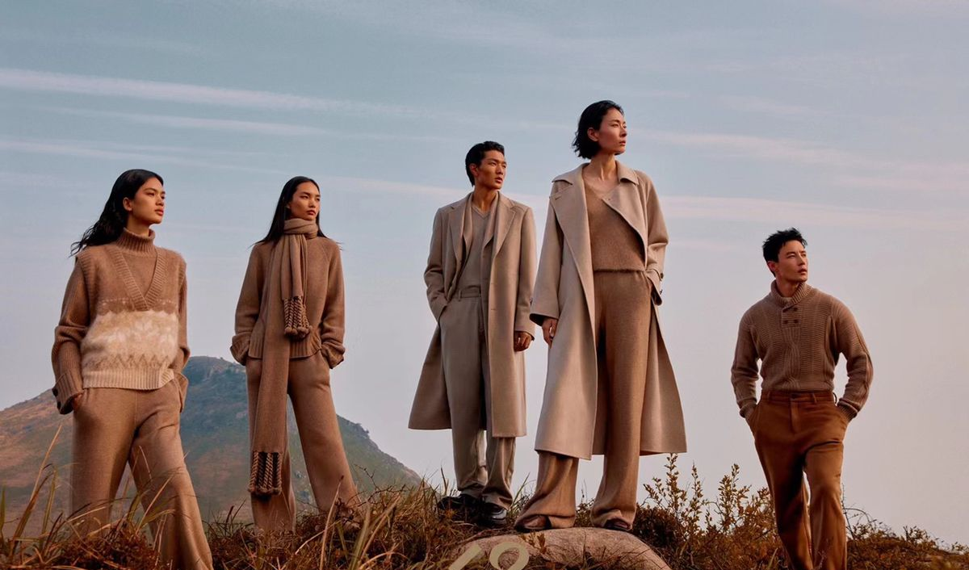
STYLESCRIPT
A simple fashion retail application

Slide 2
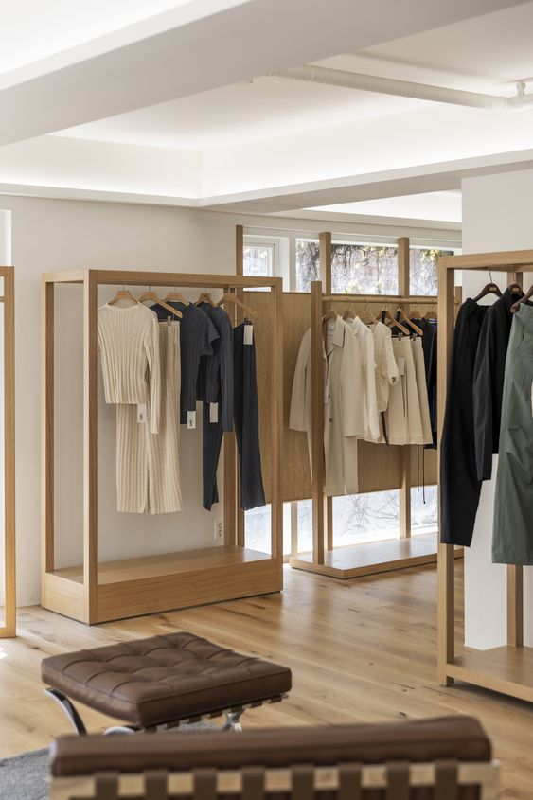
CONTENTS
01
CHOOSE YOUR CATEGORY
Select from any of the 3 types of fashion products that we offer.
02
ORDER FROM OUR DIVERSE COLLECTION
Browse the product list from each 3 categories and order your desired item.
03
VIEW YOUR CART
After ordering, see your cart of all the products you have ordered. Receive your token number to continue to payment.
04
PAY SEAMLESSLY
Enter your token number and pay the due amount of bill.

Slide 3
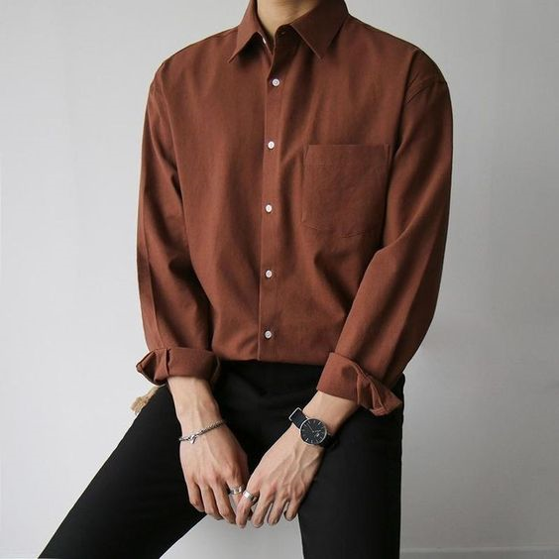
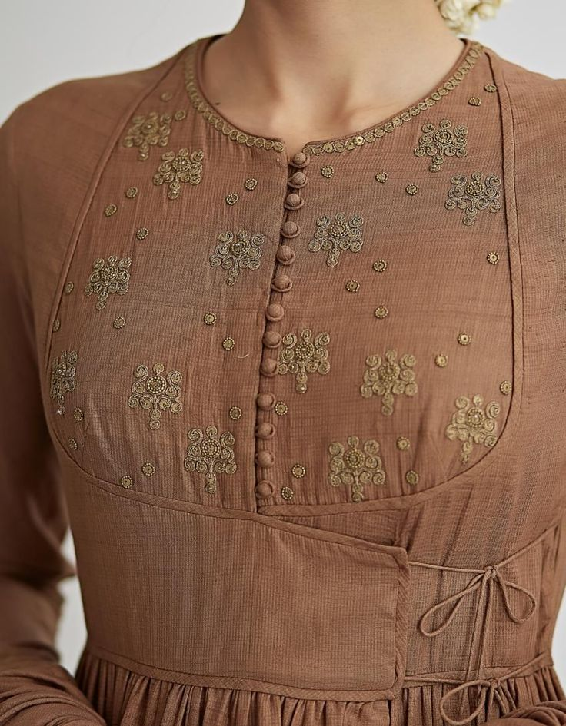
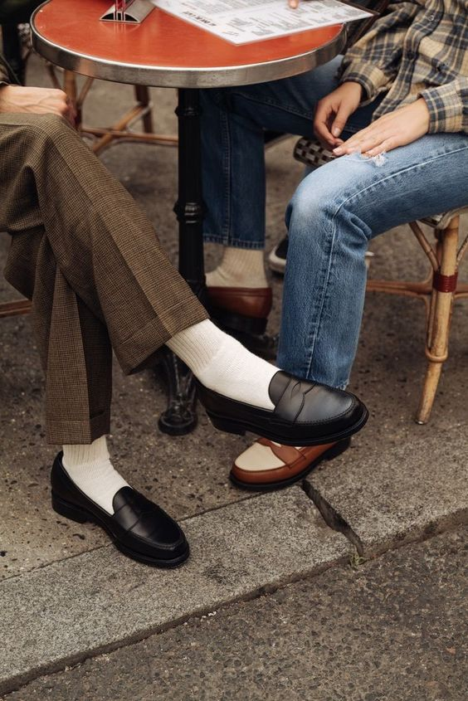
CHOOSE YOUR CATEGORY
Men’s Clothes
Women’s Clothes
Shoes

Slide 4
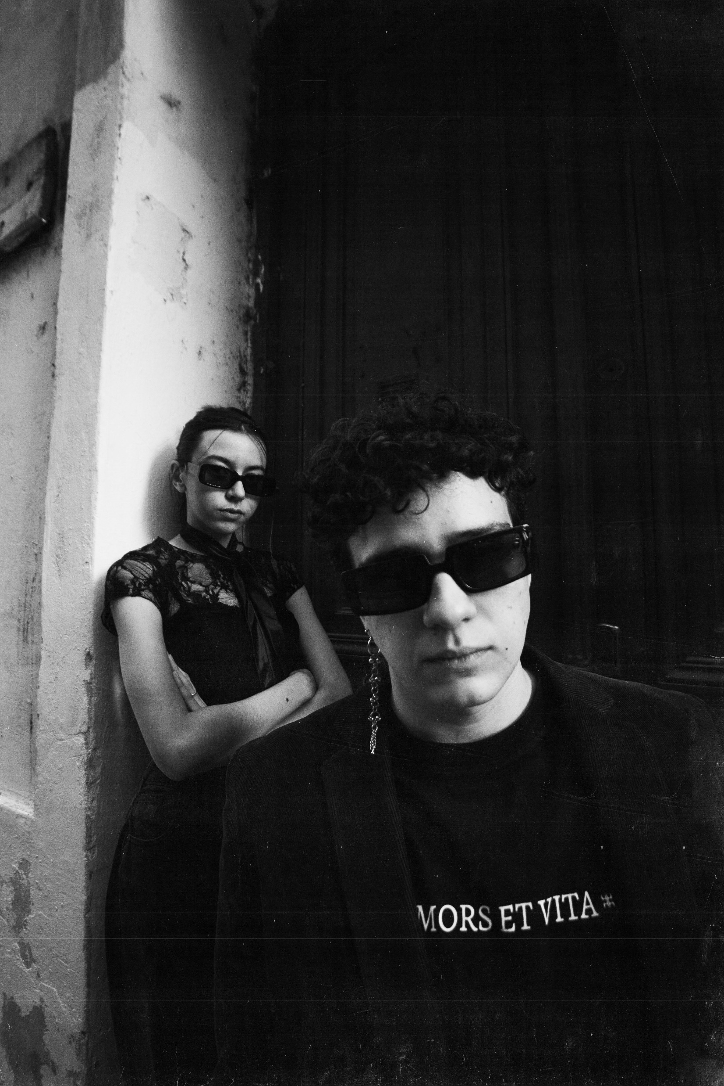
ORDER FROM OUR DIVERSE COLLECTION
From each 3 categories, venture through our diverse product list. Select your desired product ID to start your order. Choose your desired colour and size to confirm your order.

Slide 5

VIEW YOUR CART
After ordering, see the cart of all your ordered products. Receive the token number and continue to paying the bill.

Slide 6

PAY SEAMLESSLY
Enter your token number and pay your due amount and receive your changes. Enjoy the stylish products you’ve just ordered from us.

Slide 7
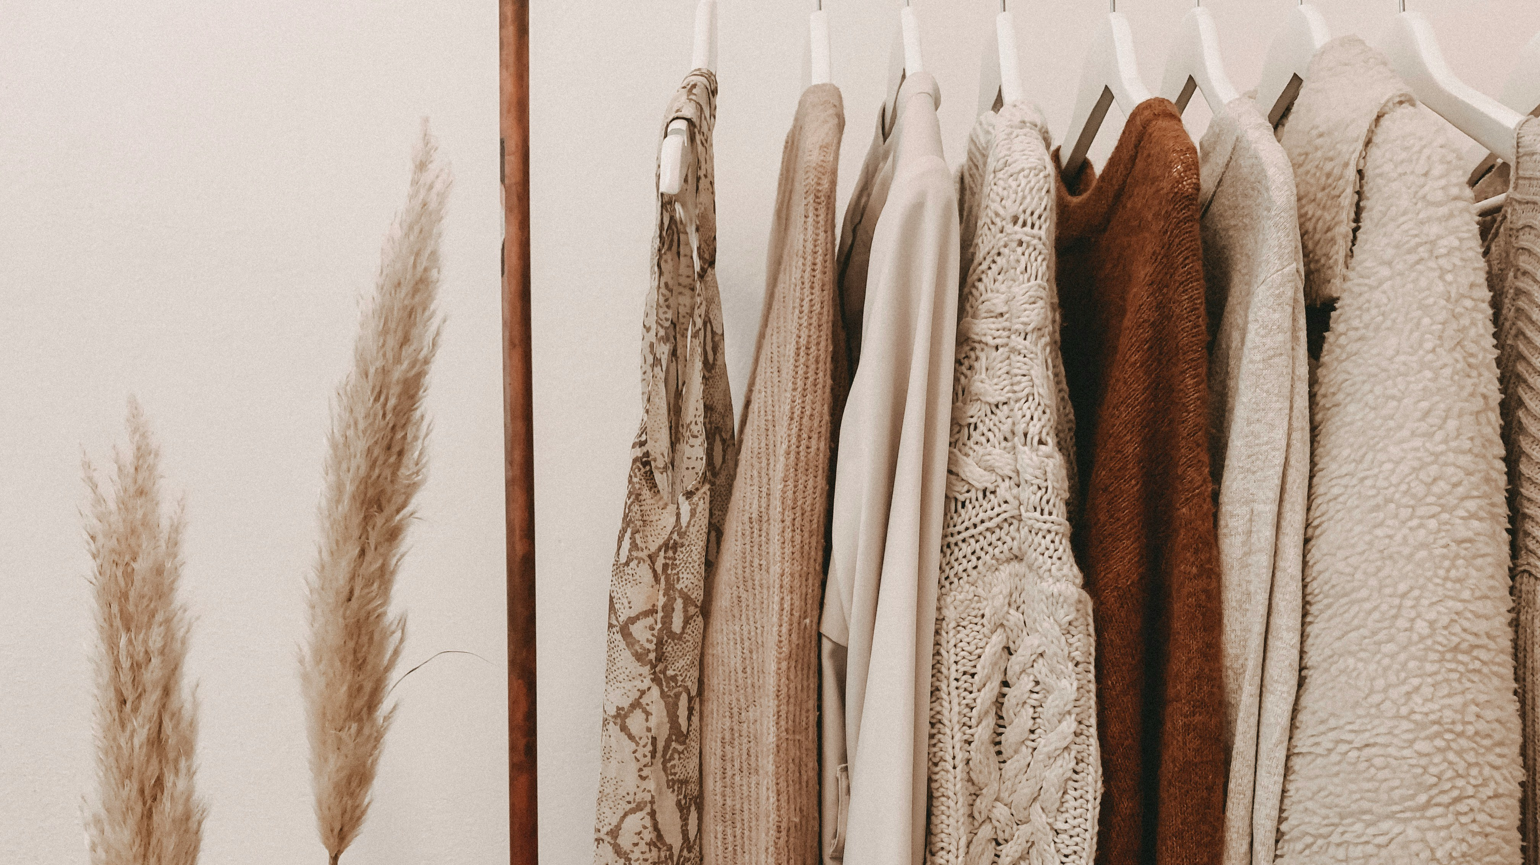
PRESENTED BY
Imran Ahammed
Mushfiq Haider Arnob
Sabrina Hamid
Nahid Islam Mohit
Shuva Pal
THANK YOU

Slide 8
TARGETS:
ACHIEVEMENTS
1. To store and manage multiple orders.
2. To process orders and stock of the products
3. Proper payment system
4. Error handling
5. Easy user experience
1. Up to 100 orders can be stored and managed simultaneously
2. Orders could be stored in multiple carts and billed separately
3. Took payment from user and could generate changes.
4. Updates in stock and quantities could not be stored in an external file
5. Most of the errors could be handled.
6. Took user inputs at each step

